Slide 1
Clustering the stack traces of ML/DL applications using various models
Amin Ghadesi, Roozbeh Aghili
Winter 2022

Slide 2
Problem
Bug triage
A lot of bugs
Without any label data
Importance
Saves time and energy
Correct assignment of errors
Clustering not Classification
1

Slide 3

Problem
Bug triage
A lot of bugs
Without any label data
337k bugs
2001 - 2010
Importance
Saves time and energy
Correct assignment of errors
Clustering not Classification
2

Slide 4
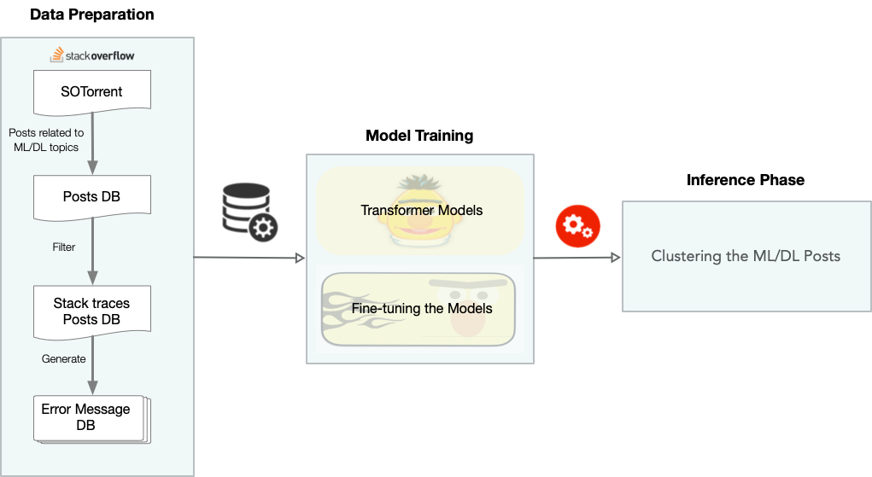
3

Slide 5
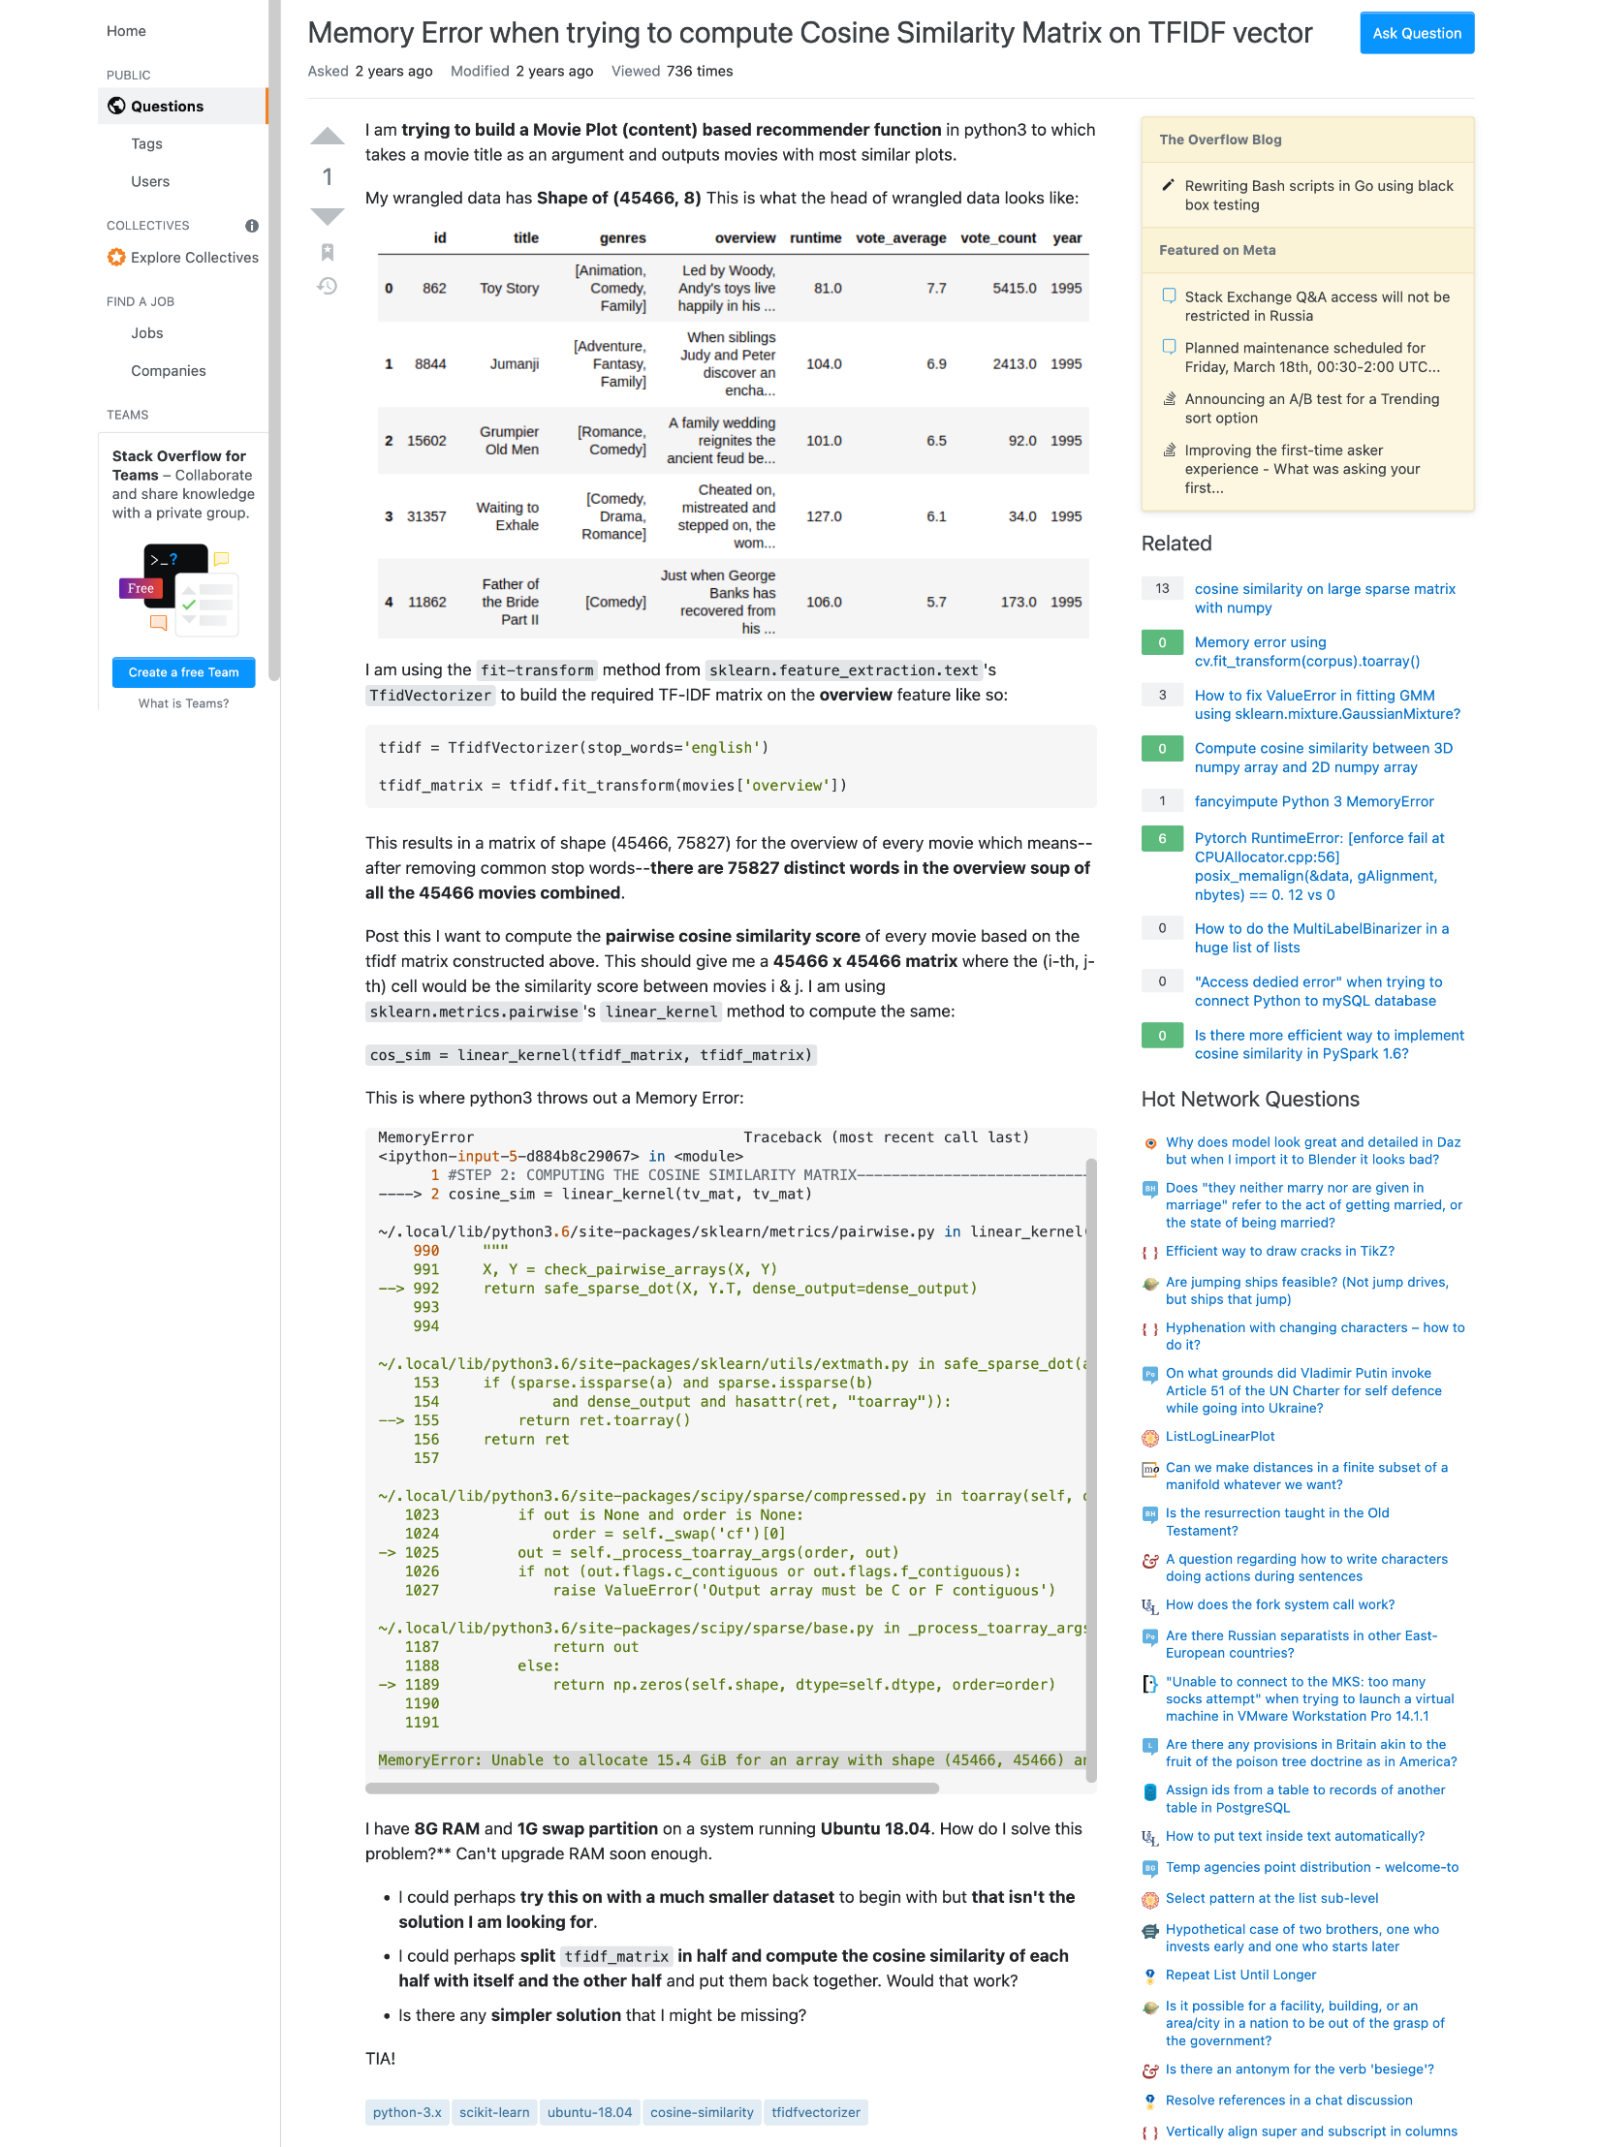
5

Slide 6
Title
Body
Stack Trace
Tags
6

Slide 7
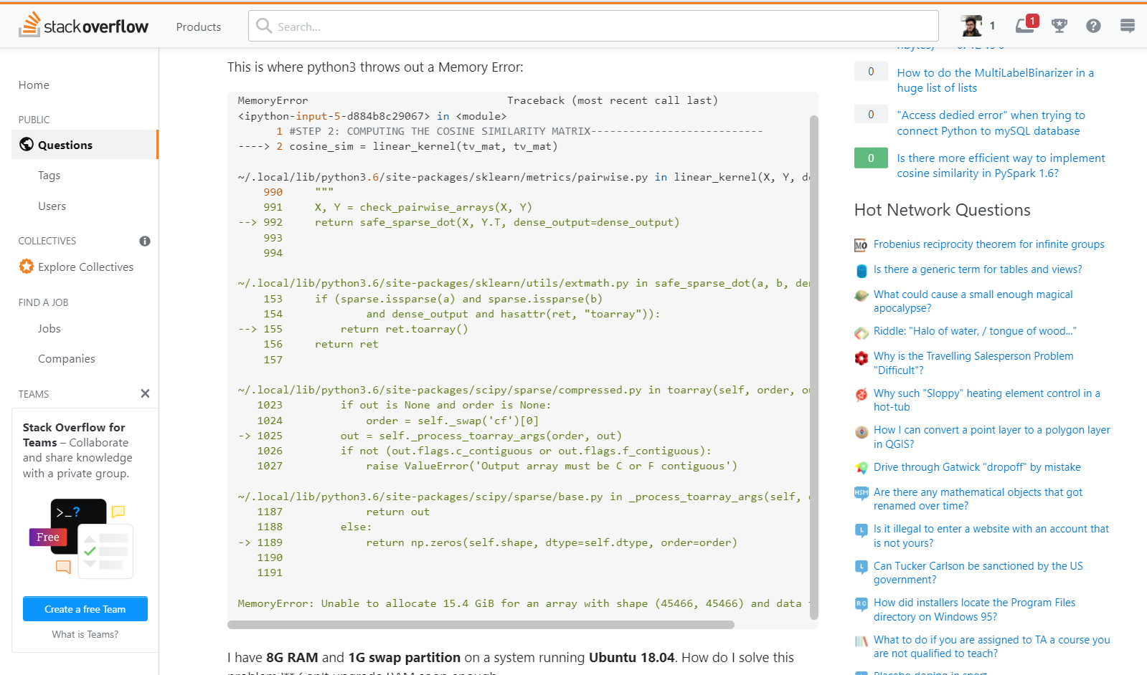
7

Slide 8
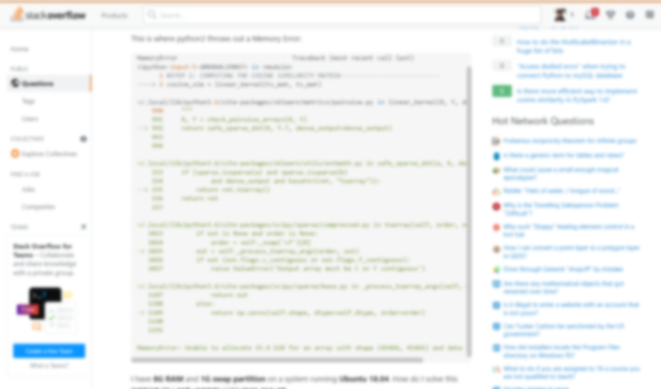
8

Slide 9

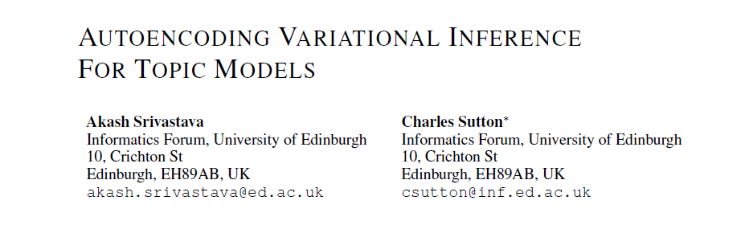
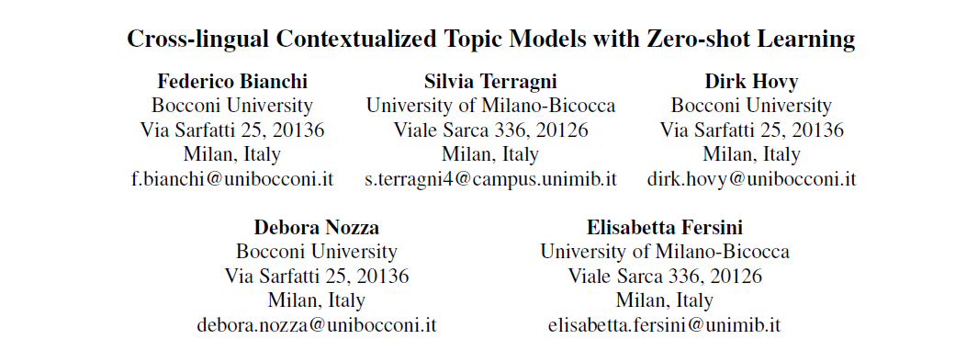
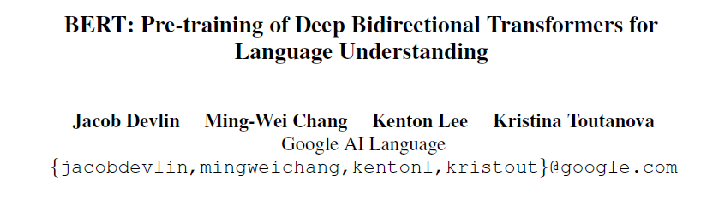
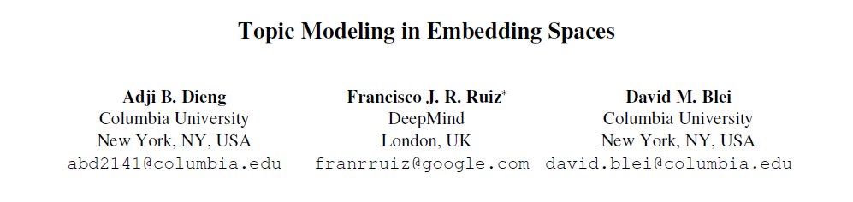
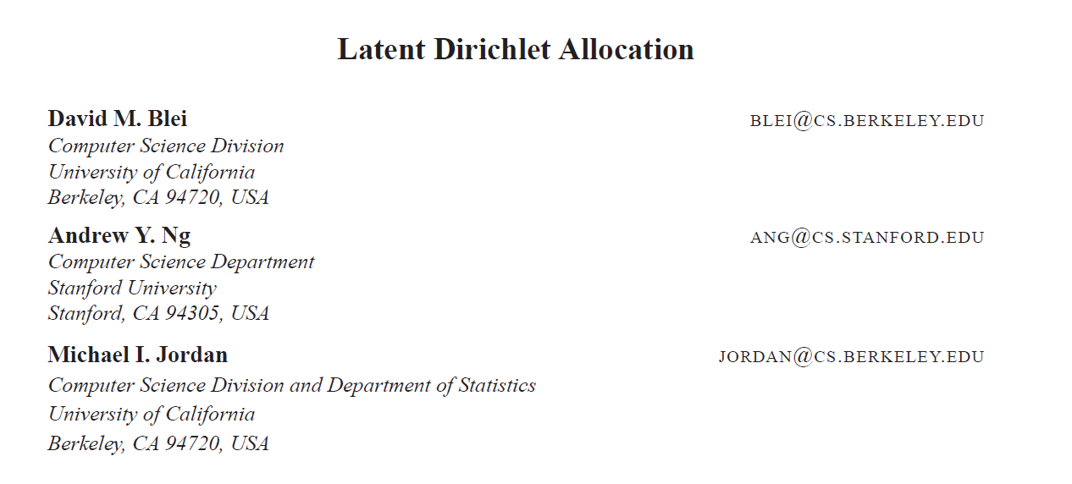
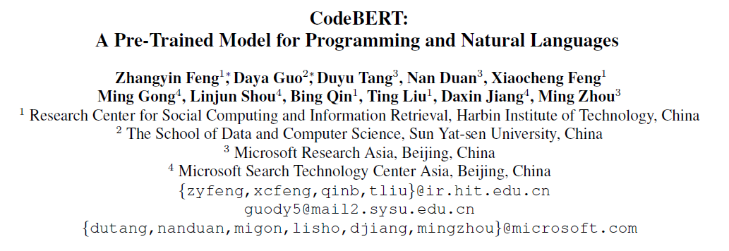
BERT
CodeBERT
ETM
NeuralLDA
CTM
LDA
4

Slide 10
